Slide 1
Introduction to Infrastructure as Code
Subtitle Goes Here

Slide 2

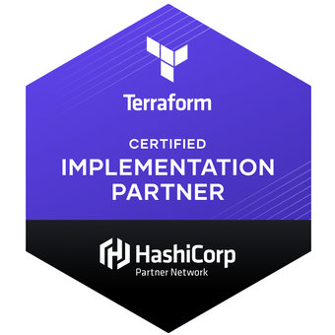
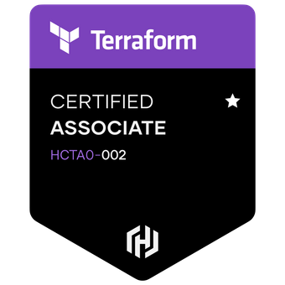
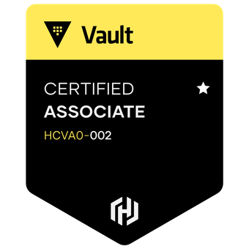
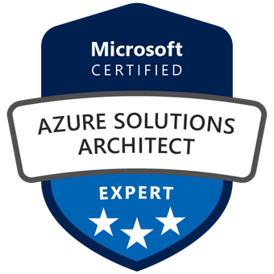
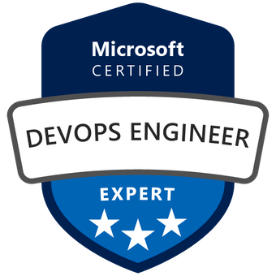
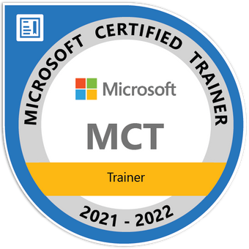
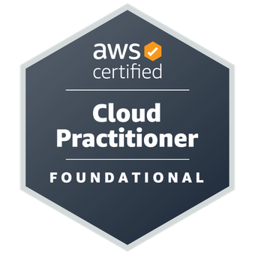


Lino Tadros
Technical Fellow – Solliance, Inc
Microsoft MVP for 15 years
Microsoft Regional Director
Former member of the Delphi & C++ development team at Borland.
Microsoft established Technical Speaker worldwide (54 countries) in the last 29 years.
Chief Architect of major projects for NASA, Disney, HP, Morgan Stanley, Johnson & Johnson, Chevron, Shell, Dell, Bank of America, Wells Fargo, State of CA, and many others…
Author of 14 technical books for the last 18 years
Carries 17 certifications on Azure, AWS, GCP and Hashicorp
Expert on AI & Machine Learning, Xamarin, iOS, Android, ASP.NET MVC, Azure Cloud, AWS, Google Cloud, SQL databases, Cosmos DB, Crypto, Ethereum and Testing tools.

Slide 3
Agenda
12:00 pm to 7:00 pm EST
Lunch at 3:00 pm EST for 1 hour
12:00 to 1:00 pm → Presentation
1:00 to 1:15 pm →Break
1:15 to 2:00 pm → Demos
2:00 to 3:00 pm → Lab time
3:00 to 4:00 pm → Lunch
4:00 to 4:30 pm → Presentation
4:30 to 5:30 pm →Demos
5:30 to 5:45 pm →Break
5:45 to 7:00 pm → Lab time

Slide 4

Infrastructure as Code, also known as Programmable Infrastructure, is a process for managing computing and networking infrastructure using software development methodologies. These methodologies include version control, testing, continuous integration, and other practices.
Raka Mahesa – Author – Packt
Notes:
Source for the quote: https://hub.packtpub.com/what-does-infrastructure-code-actually-mean/

Slide 5
Benefits of Infrastructure as Code (IaC)
Full SDLC tooling (Source control, CI/CD)
Infrastructure documentation and creation
Correct environmental drift
Deploy identical environments (dev/test/qa/prod)
Environment consistency
Speed
History/Accountability
Lower infrastructure management cost
Notes:
Full SDLC tooling: Because the infrastructure is modeled in code, the entire coding ecosystem applies to IaC, including source control, GitOps and CI/CD
Infrastructure documentation and creation: As well as creating the environment, the code acts as documentation and source of truth
Correct environmental drift: Because code is the source of truth, the IaC tool can also correct environmental drift. Without IaC, teams must maintain the settings of individual deployment environments. Over time, each environment becomes a snowflake, that is, a unique configuration that cannot be reproduced automatically. Inconsistency among environments leads to issues during deployments. With snowflakes, administration and maintenance of infrastructure involves manual processes which are hard to track and contributes to errors.
Deploy identical environments: New environments can be created automatically using the same code
Environment consistency increases the likelihood that applications that run in one environment are portable to the next environment. Infrastructure as Code enables DevOps teams to test applications in production-like environments early in the development cycle. These teams expect to provision multiple test environments reliably and on demand. Infrastructure represented as code can also be validated and tested to prevent common deployment issues. At the same time, the cloud dynamically provisions and tears down environments based on IaC definitions.
Speed. Infrastructure as Code is a force multiplier. Tools themselves can determine which tasks can be performed in parallel. Pipelines can deploy whole environments in parallel, consistently without adding staff.
History/Accountability. Source control system records who changed what and when. Pipelines record who deployed the changes.
Lower infrastructure management cost – more automation equates to a savings of both time and cost. Spending less time on manual configuration and management allows organizations to redirect professionals to higher priority efforts.

Slide 6


Infrastructure as Code Options
/
{ ; }
Declarative
Imperative
ARM
CloudFormation
Pulumi
Terraform
CLI
Postman Collections (REST)
SDK
Notes:
What are our options?
Imperative vs Declarative
“automating the CLI” -> generally imperative
Dedicated IaC tooling -> generally declarative
ARM, CloudFormation, Pulumi, Terraform – declarative
The preferred approach to IaC is to use declarative definition files where possible. A definition file specifies the what an environment requires and not the how. In other words, it may define the specific version and configuration of a cloud asset but does not dictate the process for installing and configuring it. This abstraction allows for greater flexibility as it is the infrastructure provider that handles and optimizes the installation. It also helps reduce the technical debt of maintaining imperative code, such as deployment scripts, that can accrue over time.
In the case of this workshop we’ll be concentrating on the declarative option, and Terraform in particular.

Slide 7

What is the truth?
You CAN handle the truth!
Code is the source of truth
Not all infrastructure needs to be managed by code
Code is the truth – NOT the deployment

Slide 8

Benefits of version control
For IaC code
Version control / history
Unit testing
Code scans
Policy checks/enforcement
CI/CD
Cost checks
Notes:
Make code your single source of truth for all your infrastructure management concerns.
Version control all of your configuration files. This also serves as built-in documentation
Test and Monitor Your Configurations. IaC is code, and like all code, it can be tested using testing and monitoring tools for IaC, you can check for errors and inconsistencies in your configurations before you deploy them to production.
Cost checks – with IaC code, you know exactly what is included in each configuration, thus can determine the cost of the infrastructure that would be deployed.

Slide 9

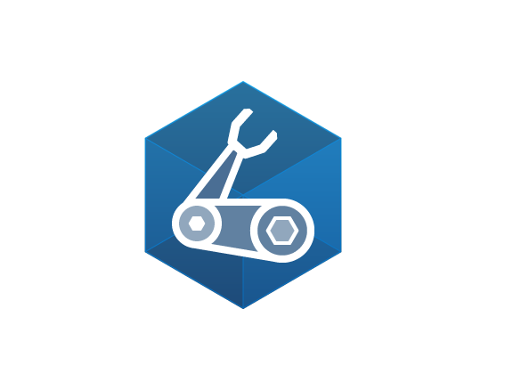

ARM Templates Vs Bicep Vs Terraform
ARM
Declarative
Azure Only
JSON based
Structured Schema
Done once deployed
Bicep
Declarative
Azure Only
Github Actions
Occurs inside Azure
Authenticate via token
AZ Policy pre-check
Portal Integration
Automatic Drift
CAF built in
Support Modules
Supports “What-if”
Full Azure Coverage
Terraform
Declarative
Multi-cloud
On Premises workloads
Github Actions
Occurs in the Terraform Client
Authenticate via provider Cred
AZ Policy is checked during Apply
Portal Integration “Terrafy”
Drift has to be imported
CAF utilizes a module to deploy
Support Modules
Supports “Plan”
Azure Coverage through AzureRM and AzAPI

Slide 10
Terraform 101

Slide 11
Putting the DevOps into IaC
Terraform CLI workflow is easy to learn and works great.
Terraform Cloud provides layer of well-designed automation.

Slide 12
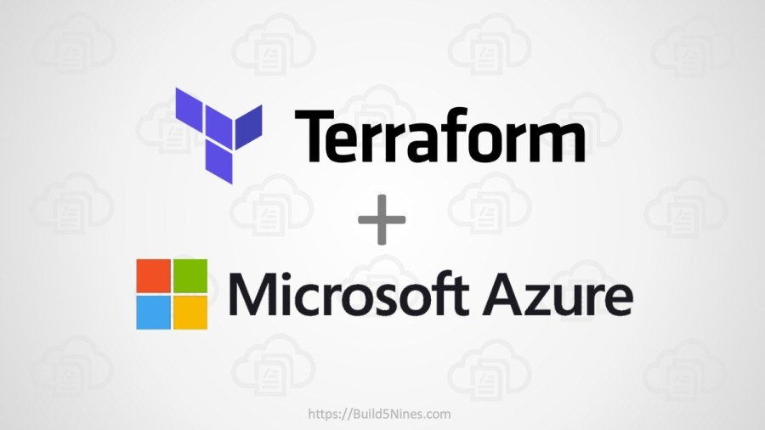
Terraform
Tool for building, changing, and versioning infrastructure safely and efficiently
Terraform can manage existing and popular service providers as well as custom in-house solutions
Configuration files describe to Terraform the components needed to run a single application or entire cloud & data center

Slide 13
Terraform ecosystem
Documentation
Available on the website (www.terraform.io)
Documentation
Tutorials
Certification training
Public registry
Search and discover
Providers and modules
Multiple clouds, companies, technologies
Full code available for Terraform (github.com/hashicorp/terraform)
Submit issues
Fix issues
GitHub
Notes:
Terraform ecosystem
Docs
Public registry
Github
Terraform Cloud (covered later with State)
Third party tooling

Slide 14
Terraform ecosystem – some optional tooling
tfsec
Static code analysis
Utilizes security best practices for a number of providers
Outputs actionable list of vulnerabilities
Trivy
Scans for vulnerabilities and misconfigurations
Detects vulnerabilities in IaC code as well as container images, filesystem, Git repos
Automated tests for infrastructure code
Validate deployed infrastructure
Terratest
Notes:
Terraform ecosystem
Docs
Public registry
Github
Terraform Cloud (covered later with State)
Third party tooling

Slide 15

Terraform terms
Terraform File – A Terraform file (.tf) that contains Terraform configuration language code.
Terraform Project – A directory / folder that contains one or more Terraform files that are all a part of the same infrastructure deployment.
Resources – The primary construct in Terraform. These are the things that will be provisioned, like Storage Accounts, Virtual Machines, Virtual Networks, etc.
Providers – The “plugins” that enable Terraform to know about and work with resources within Microsoft Azure or another cloud providers.
Variables – A name given to a value so it can be referenced in one or more locations within a Terraform file. Similar to a Variable in any other programming language.
Input Variables – Values that are passed into your Terraform when running a deployment. These can be passed in using the Terraform CLI, or as Environment Variables.
Module – Essentially a directory / folder of Terraform files that are re-used across multiple Terraform deployment(s) project(s).

Slide 16
Terraform commands
terraform init – initialize the current directory of Terraform files
terraform plan – process the Terraform files and create an execution plan for what infrastructure needs to be created or updated according to the Infrastructure as Code contained within the Terraform files.
terraform apply – take the execution plan and apply it to perform all the creation and updating of infrastructure resources and save the new state of infrastructure in the Terraform state file.
terraform destroy – destroy or delete all the infrastructure that was previously deployed (created or updated) for the Terraform project. Basically, tear it all down!
terraform -h – when is doubt on Terraform CLI commands, get some help.

Slide 17
Terraform workflow overview
init
plan
apply
Build Pipeline
Release
Initializes:
Providers
Modules
Connects to State
Evaluate:
Refresh
Compare
Graph
Outputs what “will” happen
Takes action:
Deploys per the plan

Slide 18
Terraform Workflow
What is the current state of the environment?
What does this code say the environment should be?
Here is my plan to get the environment into the desired state
Should I apply it?
Ok, I’m Applying it
Save the new current state

Slide 19
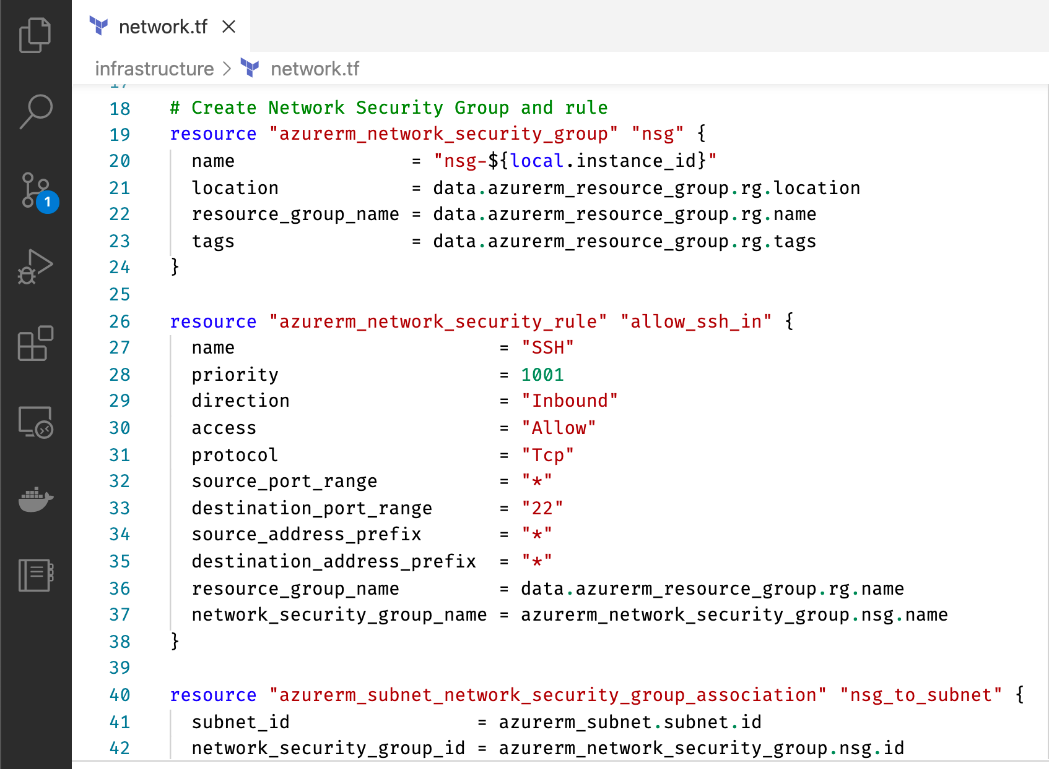
What does a Terraform file look like?
Terraform uses HashiCorp Configuration Language (HCL)
A bit of a cross between YAML and JSON

Slide 20
One File example
provider "azurerm" {
# AzureRM provider 3.x
version = "~>3.0"
features {}
}
# Create a resource group
resource "azurerm_resource_group" "b59" {
name = "b59-rg"
location = "North Central US"
}
# Create an Azure Storage Account
resource "azurerm_storage_account" "b59storage" {
name = "b59storage"
resource_group_name = azurerm_resource_group.b59.name
location = azurerm_resource_group.b59.location
account_tier = "Standard"
account_replication_type = "GRS"
tags = {
environment = "dev"
}
}
Provider tells TF which of the provider to download
Resource block tell which type of resource to create using the provider
AzureRM provider will be downloaded at init
Resource Group & Storage Accounts created based on their usage in the code written
Notes:
Terraform code
Resources
Data providers
Special blocks like terraform and provider
Modules

Slide 21

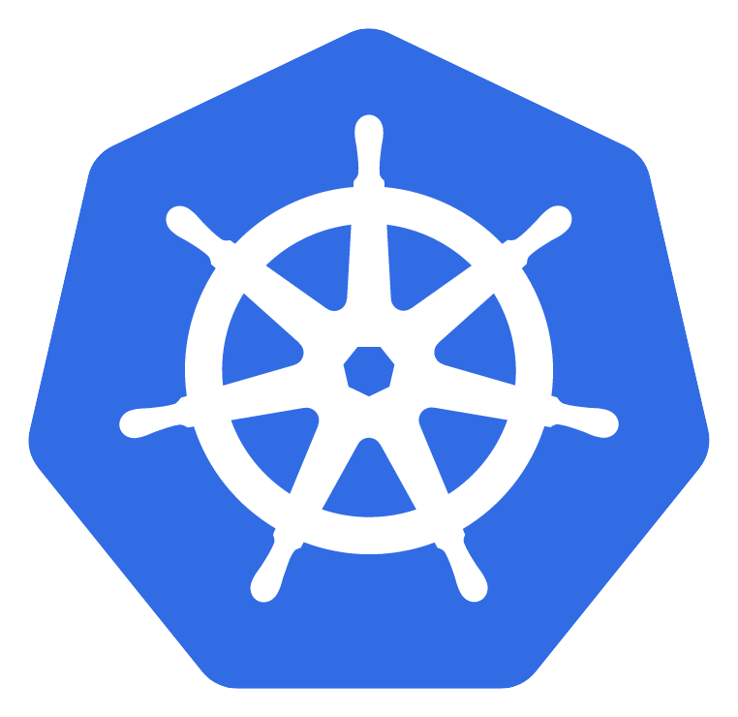



A sampling of Terraform providers
Notes:
Terraform providers
Multi-cloud / multi-saas
Other clouds: GCP, AWS, Digital Ocean

Slide 22

Terraform and Azure
1000+ modules (as of July 2022)
HIGHLIGHTS
azurerm by HashiCorp the official provider of lifecycle management in Azure
azuread provider for managing security and authentication in Azure (by HashiCorp)
azuredevops by Microsoft for DevOps
Notes:
Azure Family: AzureRm, Azure AD, Azure Devops

Slide 23
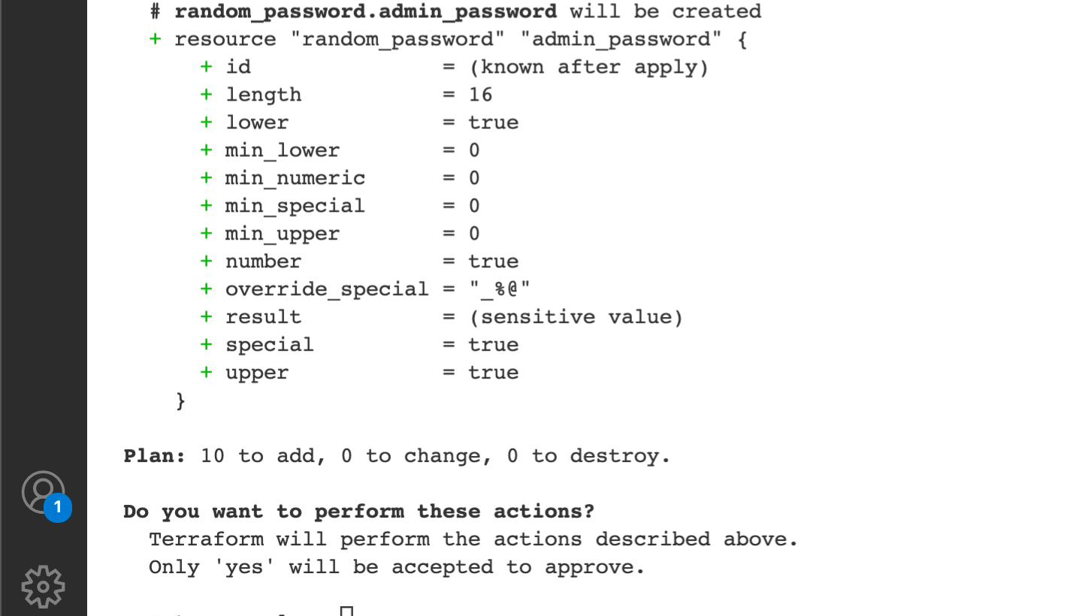
Terraform Safety is All About The Plan
Safe plan, Safe Deployment
Terraform cannot determine safety for you
Terraform asks for approval to make changes
Your responsibility: review plan and provide approval (or deny)

Slide 24
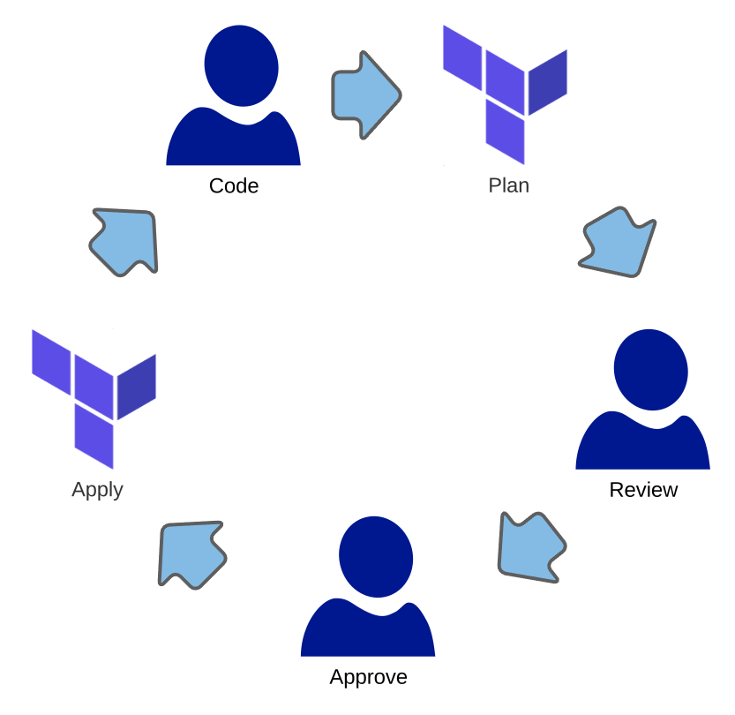
Use Explicit Terraform Plans
Explicit plan files are the critical design feature for automation
Safety—You can review an explicit plan
Approval—Invoking Terraform with a plan file is the same as approving the plan
✔
✔
✔

Slide 25
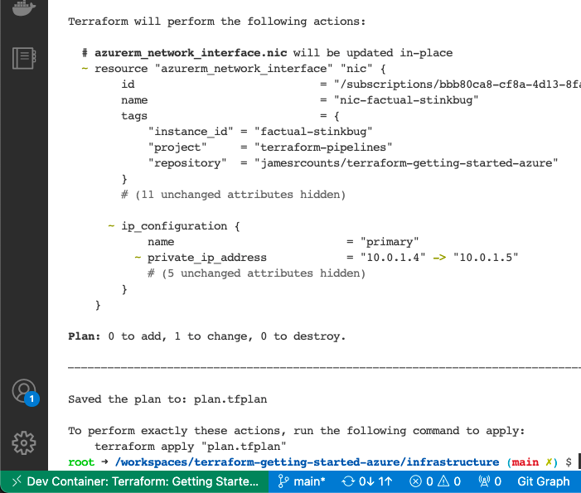
Creating a plan file
Use the plan command
“terraform plan” is just like apply…
Except it makes no attempt to change infrastructure
Use the “-out” parameter, to save the plan to a file

Slide 26
Explicit Plan Files Are Approved Plans
Terraform skips the interactive prompt when using an explicit plan file
You explicitly created the plan
You explicitly supplied the plan to Terraform
Combined, these actions represent your approval

Slide 27
Plan Review vs Code Review
Plan
Review
Apply
Code
Approve
Code Reviews are important, but are up to interpretation
The plan is the final word on what Terraform will try to do
Terraform wins every* disagreement
Actually… Azure has the final word.

Slide 28

Options for state
Local
Cloud Storage
Terraform
Cloud
Don’t check it into scm!!

Slide 29
Terraform cloud
^{Remote state}
^{Centralized runs}
^{Plan approvals}
^{Historical reporting}
^{Team work makes the dream work}

Slide 30
Standard Vs Enhanced Backends
Standard Backends:
AWS S3 Bucket Storage
Azure Blob Storage
Google GCS Object Storage
Alibaba OSS Object Storage Service
OpenStack Swift Rackspace Storage
Tencent Cloud Object Storage COS
Manta Joynet Cloud Storage
Hashicorp Consul
etcd etcdv3
Postgres Database
Kubernetes Secrets
HTTP Protocol with REST API

Slide 31
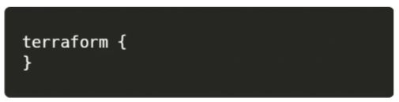
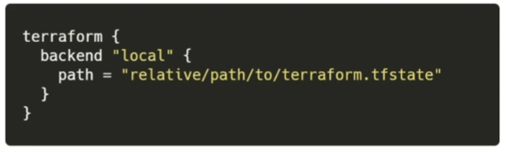
Enhanced Backends…
Local backends:
Stores state on local file system
Locks that state using system APIs
All operations are performed locally
=

Slide 32
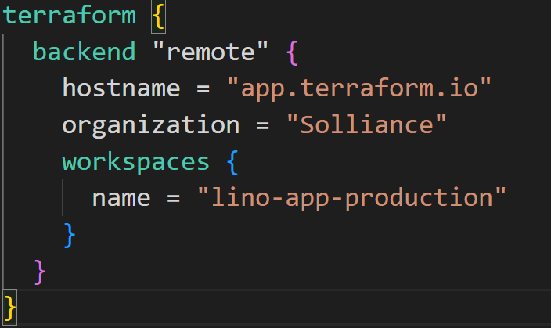
Enhanced Backends…
Remote backends:
Terraform Cloud
Terraform Enterprise
* Run environment is responsible for executing the operation
** Need to setup Workspaces for Remote backends to work

Slide 33
Terraform Cloud

Slide 34
Terraform Cloud Features
Manages your state files
History of previous runs
History of previous states
Easy and secure variable injection
Tagging
Run Triggers (chaining workspaces)
Specify any version of terraform per workspace
Global state sharing
Commenting on Runs
Notifications via Webhooks, Email, Slack
Organization and Workspace Level Permissions
Policy as Code (via Sentinel Policy Sets)
MFA,
Single Sign On (SSO) (at Business tier)
Cost Estimation (at Teams and Governance Tier)
Integrations with ServiceNow, Splunk, K8, and custom Run Tasks

Slide 35
Terraform Cloud Structure
Organization
Organizations
An organization is a collection of workspaces
Workspaces
A workspace belongs to an organization
A workspace represents a unique environment or stack
Teams
A team is composed of multiple members (users).
A team can be assigned to workspaces
Runs
A run represents a single run of the terraform run environment that is operating on an execution plan.
Runs can be UI/VCS driven API driven or CLI driven
Workspace
Team1
Run
Run
Run
Workspace
Team2
Run
Run
Run
Workspace
Run
Run
Run

Slide 36
Final Lab Overview

Slide 37
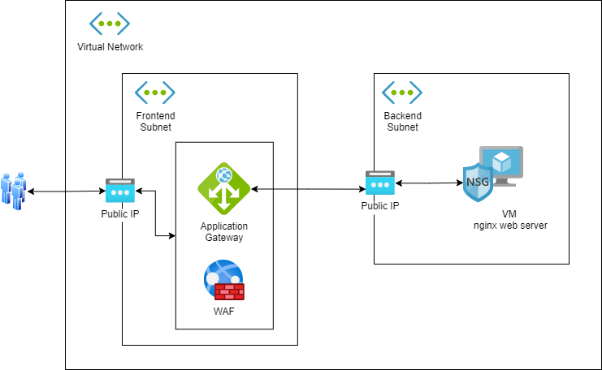
Infrastructure to Deploy
Notes:
Picture this…. Sicily… (just kidding)
For the Lab 1 scenario, a Virtual Network is deployed with two subnets Frontend and Backend. In the Frontend subnet, the application gateway is deployed using the web application firewall sku, and is exposed to the internet via a public IP address. Communication to the application gateway is made over HTTP port 80. The application gateway then forwards HTTP(80) requests to the backend pool, which consists of a Linux VM with the lightweight NGINX server installed. This server is located in the Backend subnet, and is also exposed to the application gateway via a Public IP.

Slide 38

Public IPs
Only Internet facing devices: WAF, FW, GW
IP Blocks can be setup
Standard SKU

Slide 39

Network Security Groups
Establish connectivity rules
Inbound
Outbound

Slide 40

Application Gateway & Web Application Firewall (WAF)
WAF deployed in front of the Firewall
Inspect traffic for HTTP attacks using the OWASP rules
Static HTML page to preview showing the user a 503 if the backend is down

Slide 41

Virtual machine
NGINX
Ubuntu

Slide 42

Lab Time - Final Lab
Feel free to ask questions to your instructors

